Slide 1
CS 211 Computer Architecture Lecture 16: RISC-V Instructions – Array Implementation, Function Calls, Jump Instructions
Ravi Mittal
ravi.mittal@iitgoa.ac.in
Indian Institute of Technology, Goa

Slide 2
Acknowledgements
Class Presentation, CS61C, Introduction to Assembly Language and RISC-V Instruction Set Architecture, University of Berkeley, Prof Krste Asanović & Randy H. Katz. http://inst.eecs.Berkeley.edu/~cs61c
Digital Design and Computer Architecture: RISC-V Edition, Harris & Harris Elsevier – Presentation.
Computer Organization and Design, The Hardware Software Interface, RISC-V edition, Patterson and Hennessey

Slide 3
In today’s class we will study
Array Implementation in RISC-V
Function Calls – Basics
RISC-V Symbolic Register Names
Fundamental Steps in calling a function (in RISC-V)
Jal : Jump-and-Link Instruction
Function Calls in C and RISC-V assembly
Input Arguments and return value

Slide 4
Previous Classes

Slide 5
So far we have studied
Arithmetic operations: add, sub, addi,
How to bring data from memory to register and vice versa?
lw, sw, lb, sb, lbu
Bit-by-bit logical instructions
and, or, xor
andi, ori, xori
Logical Shift instructions
sll, srl, sra
slli, srli, srai
Generating Constants
Branching Instructions: beq, bne, blt/bltu, bge/bgeu
Jumping instruction: j
Assembly level program for: if, if/else, while, for loops

Slide 6
Acknowledgements
Digital Design and Computer Architecture: RISC-V Edition, Harris & Harris Elsevier – Presentation.
Class Presentation, CS61C, Introduction to Assembly Language and RISC-V Instruction Set Architecture, University of Berkeley, Prof Krste Asanović & Randy H. Katz. http://inst.eecs.Berkeley.edu/~cs61c
Computer Organization and Design, The Hardware Software Interface, RISC-V edition, Patterson and Hennessey

Slide 7
Array Implementation in RISC-V Assembly Instructions

Slide 8
Arrays
Access large amounts of similar data
Index: access each element
Size: number of elements
Ref: Harris and Harris Book: Digital Design and Computer Architecture: RISC-V Edition

Slide 9
Arrays
200-element array; Consecutive address increases by 4
Base address = 0x174300A0 (address of 0th element, score[0])
First step in accessing an array: load base address into a register
Write grade inflation algo
Add 10 points to each score value
Ref: Harris and Harris Book: Digital Design and Computer Architecture: RISC-V Edition

Slide 10
RISC-V Assembly Code
High-Level Code int i; int scores[200]; for (i = 0; i < 200; i = i + 1) scores[i] = scores[i] + 10; | RISC-V Assembly Code # s0 = scores base address, s1 = i # Assume s0 contains 0x174300A0 addi s1, zero, 0 # i = 0 addi t2, zero, 200 # t2 = 200 for: bge s1, t2, done # if i >= 200 then done slli t0, s1, 2 # t0 = i*4 add t0, t0, s0 # address of scores[i] lw t1, 0(t0) # t1 = scores[i] addi t1, t1, 10 # t1 = scores[i]+10 sw t1, 0(t0) # scores[i] = t1 addi s1, s1, 1 # i = i+1 j for # repeat done:
Ref: Harris and Harris Book: Digital Design and Computer Architecture: RISC-V Edition

Slide 11
Arrays using For Loops: Example 2
// C Code
int array[1000];
int i;
for (i=0; i < 1000; i = i + 1)
array[i] = array[i] * 8;
# RISC-V assembly code
# s0 = array base address, s1 = i
Ref: Harris and Harris Book: Digital Design and Computer Architecture: RISC-V Edition

Slide 12
Arrays using For Loops: Example 2
# RISC-V assembly code
# s0 = array base address, s1 = i
# initialization code
lui s0, 0x23B8F # s0 = 0x23B8F000
ori s0, s0, 0x400 # s0 = 0x23B8F400
addi s1, zero, 0 # i = 0
addi t2, zero, 1000 # t2 = 1000
loop:
bge s1, t2, done # if not then done
slli t0, s1, 2 # t0 = i * 4 (byte offset)
add t0, t0, s0 # address of array[i]
lw t1, 0(t0) # t1 = array[i]
slli t1, t1, 3 # t1 = array[i] * 8
sw t1, 0(t0) # array[i] = array[i] * 8
addi s1, s1, 1 # i = i + 1
j loop # repeat
done:
Ref: Harris and Harris Book: Digital Design and Computer Architecture: RISC-V Edition

Slide 13
Characters in RISC-V

Slide 14
ASCII Code (self reading)
American Standard Code for Information Interchange
Each text character has unique byte value
For example, S = 0x53, a = 0x61, A = 0x41
Lower-case and upper-case differ by 0x20 (32)

Slide 15
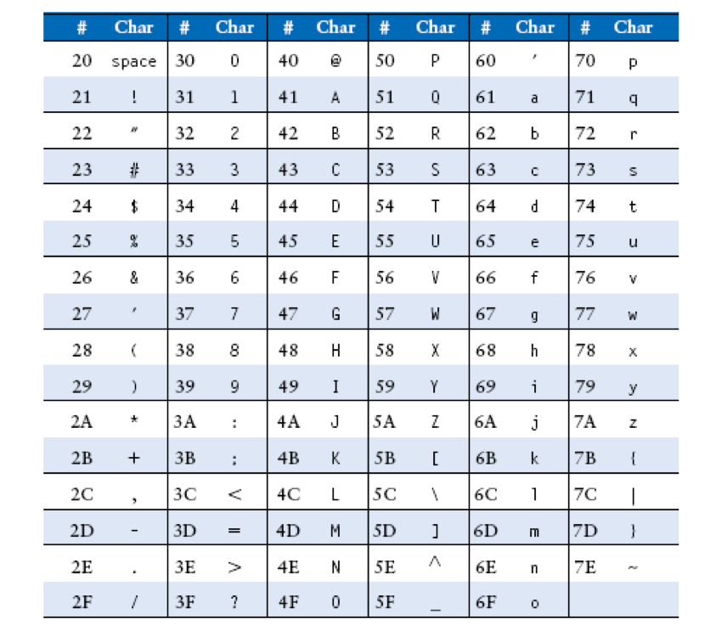
ASCII Characters (self reading)

Slide 16
How to access a character array?
A series of characters such as a word or sentence is called a string
Strings have a variable length
In C, the null character (0x00) signifies the end of a string
Assignment:
In C: Write a program to convert 10 entry array of character from lower case to uppercase
Translate it into RISC-V assembly language

Slide 17
Function Calls

Slide 18
Functions (Procedures)
High level languages often use functions to reuse frequently accessed code
Functions make a program more modular and readable
Functions have
Inputs – arguments
An output – the return value
Ideally, functions should calculate the return value and not cause unintended side effects
When one function calls another, we have
Calling function: the caller
Called function: the callee
Ref: Harris and Harris Book: Digital Design and Computer Architecture: RISC-V Edition

Slide 19
Function Calls
Caller: calling function (in this case, main)
Callee: called function (in this case, sum)
C Code
void main()
{
int y;
y = sum(42, 7);
...
}
int sum(int a, int b)
{
return (a + b);
}
Ref: Harris and Harris Book: Digital Design and Computer Architecture: RISC-V Edition

Slide 20
Helpful RISC-V Assembler Features
Symbolic register names
E.g., a0-a7 for argument registers (x10-x17)
E.g., zero for x0
Pseudo-instructions
Shorthand syntax for common assembly idioms
E.g., mv rd, rs = addi rd, rs, 0
E.g. li rd, 13 = addi rd, x0, 13
Read pseudo instructions for RISC-V from the book
Assembler converts pseudo instructions to RISC-V code and coverts them to machine code
Ref: Prof Krste Asanović & Randy H. Katz, Univ of California, Berkeley

Slide 21
RISC-V Symbolic Register Names
Name | Register Number | Usage
zero | x0 | Constant value 0
ra | x1 | Return address
sp | x2 | Stack pointer
gp | x3 | Global pointer
tp | x4 | Thread pointer
t0-2 | x5-7 | Temporaries
s0/fp | x8 | Saved register / Frame pointer
s1 | x9 | Saved register
a0-1 | x10-11 | Function arguments / return values
a2-7 | x12-17 | Function arguments
s2-11 | x18-27 | Saved registers
t3-6 | x28-31 | Temporaries
Numbers hardware understands
Human-friendly symbolic names in assembly code
Ref: Harris and Harris Book: Digital Design and Computer Architecture: RISC-V Edition

Slide 22
Fundamental Steps in Calling a Function
Caller:
passes arguments to callee
Put parameters in a place where function can access them
jumps to callee (Transfer control to callee function)
Callee:
Acquire (local) storage resources needed for function
performs the function
returns result to caller
Put result value in a place where calling code can access it and restore any registers you used
returns to point of call
It must not interfere with the function of caller
It must know where to return
must not overwrite registers or memory needed by caller

Slide 23
RISC-V Function Conventions
Registers faster than memory – so use them
a0 – a7 (x10, x17): Eight argument registers to pass parameters and two return values a0, a1
ra (x1): one return address register to return to the point of origin (x1)
Ref: Harris and Harris Book: Digital Design and Computer Architecture: RISC-V Edition

Slide 24
jal: jump-and-Link Instruction
An instruction that branches to an address and simultaneously saves the address of the following instruction in a register ra (x1)
jal ra, simple
Word link - address or link is formed that points to the calling site to allow the procedure to return to the proper address
This link stored in register ra is called the return address
Return address is needed because the procedure can be called from several parts of the program
Ref: Harris and Harris Book: Digital Design and Computer Architecture: RISC-V Edition

Slide 25
jr: Jump-Register Instruction
# RISC-V assembly
0x00000200 addi s0, zero, 0x210
0x00000204 jr s0
0x00000208 addi s1, zero, 1 # not executed
0x0000020C sra s1, s1, 2 # not executed
0x00000210 lw s3, 44(s1)
Ref: Harris and Harris Book: Digital Design and Computer Architecture: RISC-V Edition

Slide 26
Jump Instructions: Summary
Jump (j)
j label
Jump Register (jr)
jr src
Jump and Link (jal)
jal dst label
Jump and Link Register (jalr)
jalr dst src imm
“and Link”: Saves the location of instruction in a register before jumping
ra = return address register, used to save where a function is called from so we can get back
Used to return from a function
(src = ra)
Used to invoke
a function
Not covered yet in the class

Slide 27
RISC-V Function Conventions
With this convention:
both functions (caller and callee) know where to find the arguments and return value, even if the caller and callee were written by different people
The caller stores the return address in register ra at the same time it jumps to the callee using the jump and link instruction (jal)
The callee must not overwrite any architectural state or memory that caller is depending on
the callee must not modify the saved registers, register ra and stack portion used by caller
Ref: Harris and Harris Book: Digital Design and Computer Architecture: RISC-V Edition

Slide 28
Function Calls
C Code
int main() {
simple();
a = b + c;
}
void simple() {
return;
}
RISC-V assembly code
0x00000300 main: jal ra, simple # call
0x00000304 add s0, s1, s1
... ...
0x0000051c simple: jr ra # return
void means that simple doesn’t return a value
Ref: Harris and Harris Book: Digital Design and Computer Architecture: RISC-V Edition

Slide 29
Function Calls
C Code
int main() {
simple();
a = b + c;
}
void simple() {
return;
}
RISC-V assembly code
0x00000300 main: jal ra, simple # call
0x00000304 add s0, s1, s1
... ...
0x0000051c simple: jr ra # return
jal ra, simple:
ra = PC + 4 (ie. 0x00000304)
jumps to simple label (PC = 0x0000051c)
jr ra:
PC = ra (i.e. 0x00000304)
Ref: Harris and Harris Book: Digital Design and Computer Architecture: RISC-V Edition

Slide 30
Function Calls
C Code
int main() {
simple();
a = b + c;
}
void simple() {
return;
}
RISC-V assembly code
0x00000300 main: jal simple # call
0x00000304 add s0, s1, s1
... ...
0x0000051c simple: jr ra # return
Preferred instruction:
jal simple - a pseudoinstruction for jal ra, simple
Pseudoinstructions are not actual RISC-V instructions but they are often simpler for the programmer.
They are converted to real RISC-V instructions by the assembler
Ref: Harris and Harris Book: Digital Design and Computer Architecture: RISC-V Edition

Slide 31
Input Arguments and Return Value
C Code
int main()
{
int y;
...
y = diffofsums(2, 3, 4, 5); // 4 arguments
...
}
int diffofsums(int f, int g, int h, int i)
{
int result;
result = (f + g) - (h + i);
return result; // return value
}
Ref: Harris and Harris Book: Digital Design and Computer Architecture: RISC-V Edition

Slide 32
Input Arguments and Return Value
RISC-V assembly code
# s7 = y
main:
. . .
addi a0, zero, 2 # argument 0 = 2
addi a1, zero, 3 # argument 1 = 3
addi a2, zero, 4 # argument 2 = 4
addi a3, zero, 5 # argument 3 = 5
jal diffofsums # call function
add s7, a0, zero # y = returned value
. . .
# s3 = result
diffofsums:
add t0, a0, a1 # t0 = f + g
add t1, a2, a3 # t1 = h + i
sub s3, t0, t1 # result = (f + g) − (h + i)
add a0, s3, zero # put return value in a0
jr ra # return to caller
Ref: Harris and Harris Book: Digital Design and Computer Architecture: RISC-V Edition

Slide 33
Input Arguments and Return Value
RISC-V assembly code
# s3 = result
diffofsums:
add t0, a0, a1 # t0 = f + g
add t1, a2, a3 # t1 = h + i
sub s3, t0, t1 # result = (f + g) − (h + i)
add a0, s3, zero # put return value in a0
jr ra # return to caller
diffofsums overwrote 3 registers: t0, t1, s3
diffofsums can use the stack to temporarily store registers
Ref: Harris and Harris Book: Digital Design and Computer Architecture: RISC-V Edition

Slide 34
Class Summary
We have studied
Array implementation in RISC-V
Function Calls
jal, jr instructions

Slide 35
Example: function in assembly
void main(void){
a = 3;
b = a+1;
a = add(a, b);
...
}
int add(int a, int b){
return a+b;
}
main:
addi a0, t0, 3
addi a1, a0, 1
jal ra, add
...
add:
add a0, a0, a1
jr ra

